Slide 1


GPT Azure Search Engine
Azure OpenAI Accelerator

Slide 2


The Need for Better Document & Knowledge Management
Improving Access to Information with Smarter Search Solutions.
80%
82%
$14 K
Amount of data in businesses that is unstructured
Of professionals say their companies struggle with efficient processing of unstructured data
Of productivity lost per year per information worker
Notes:
The reality of the world today is that information is constantly generated--Forbes recently estimated that the world creates over 2.5 quintillion bytes of new data per day. Data is coming in “unstructured” formats like PDFs, images, videos, audio files, and Powerpoints decks. In fact, around 80% of data in businesses is estimated to be unstructured.
As a result, it can cost time and money. Internally, decisions are less informed, take longer to make, work is done manually, Externally, user experience on apps can be difficult to navigate, and customers may not be able to find relevant content and products.
Information has the potential to become an asset or a burden, depending on how you use it. So how do we apply our information meaningfully to our products and businesses?
1. https://www.ricoh.nl/Images/IDC_Executive_Insights_January2011_t_76-4420.pdf
2. http://www.marketingpilgrim.com/2014/12/in-the-next-60-seconds-300-hours-of-video-will-be-uploaded-to-youtube.html
80% - Amount of data in business data is unstructured
82% of professionals say their companies struggle with efficient processing of unstructured data
$14K – productivity lost per knowledge worker each year due to information searches

Slide 3



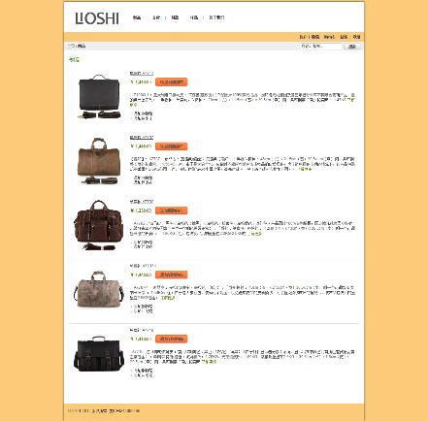
Common applications of cognitive search
Enterprise Search
(Find the right document)
Knowledge Mining
(Find the right content)
Document Intelligence
(Digitize assets)
Catalogue Search
(ecommerce, customer-facing web & mobile apps)
Find the correct document from a large repository
Increase your teams’ productivity
Enrich documents with AI: classification, Entity extraction, OCR, etc
Find answers to questions in natural language
Find relevant knowledge within large corpus of text using Semantic expansion
Find the right paragraphs within text corpus to answer specific questions
Index structured documents such as contracts, invoices, sales orders, etc
Extract important entities
Find the relevant document
Find the right information within documents
Increase relevancy of product results
Prevent “zero search results”
Deliver intelligent product recommendations based on user intent
Increase clickthrough and conversion rates

Slide 4
GPT Azure Search Engine
Your organization needs a search engine that can make sense of all kinds of types of data, stored in different locations, and that can return the links of similar documents, but more importantly, provide the answer to the question!
In other words, you want private and secured ChatGPT for your organization that can interpret, comprehend, and answer questions about your business.

Slide 5
The GPT Azure Search Engine Accelerator
Azure Cognitive Search
Azure OpenAI & ChatGPT
Create a comprehensive Azure Cognitive Search solution with Semantic Search capabilities, AI-enriched Skillsets, and multiple indexes.
Harness a blend of state-of-the-art Azure OpenAI models to develop your own intelligent search engine and secure ChatGPT.
a
1
3
e
c
o
e
p
Data
f
h
2
r
s
v
g
k
t
u
Variety of Datasets
x
Web Application
l
j
w
4
Unlock valuable insights from your datasets, whether they consist of textual data or tabular information.
n
m
aa
y
Finally, package it all together in an Azure Web Application featuring a user-friendly interface, allowing you to effortlessly search for the information you need within your data.
bb
cc
dd
Notes:
Market Challenge
Customer needs have always driven retail, but today customers expect more—personalized and on-demand service from the moment their path crosses yours, in-person or online.
Giving customers the experience they expect requires a lot more innovation than it used to—and a lot more access to data.That shift is reflected in the numbers:
78% of consumers are more likely to shop at retailers with a personalized experience
Some of the most desirable demographic groups--high-income earners and millennials--are leading the way in shifting spend online across both essential and nonessential items, (The great consumer shift: Ten charts that show how US shopping behavior is changing | McKinsey)
Retailers that cannot successfully leverage prescriptive product recommendations will find themselves off-boarded. Not only will they lose existing customers, they won't be able to attract new customers due to their lack of relevancy and ability to influence.
It's easy to see the impacts digital transformation will have on retail. But let's go further and take a look at some of the common challenges retailers are having using data today.

Slide 6






The Workshop Details
Build a working POC with your own data in your Azure tenant
We teach your team how to build the entire POC to help enable future scale and replication
Rapid prototyping and quick time to market over 3 days
Start using cutting edge Azure OpenAI models
Learn and deploy multiple Azure services
Timeline
Validate use case & send pre-reqs for workshop
One 60-minute meeting
MSFT architects build POC in client’s tenant
1-2 weeks
Completed POC!
Client prepares pre-reqs & schedules workshop
~1 week
Workshop with client
3-5 Days

Slide 7

3-5 Day Workshop Agenda
From Idea to POC in 3-5 days
Day 1
Day 2
Day 3
Overview of Azure Products and Azure OpenAI Theories
Overview of Use Case and Architecture
Walk Through of Github Repo
Notebook 1-2: Create Azure Cognitive Search – Text and Vector indexes
Notebook 3: Searching enhanced with Azure OpenAI
Notebook 4: Indexing and Searching complex/large files
Notebook 5: Implementing Memory to Power Conversations
Notebook 6: Searching Across Tabular Dataset File
Notebook 7: Talking to a SQL Databases
Notebook 8: Creating a Bing Chat Clone
Notebook 9: Talking to REST APIs.
Notebook 10: All Together – GPT Smart Search Engine Chat Bot
Notebook 11: Building the backend and frontend of the apps
Deployment of Web Application
Next Steps Discussion: Production, Partners, Support
Open Q&A

Slide 8
The Prerequisites
Before setting the 3-day Workshop the following items need to be in place
Datasets
Your own data must be uploaded at least 2 weeks prior to the workshop
Accepted application to Azure OpenAI (AOAI)
After you have been accepted please apply for GPT-4
Azure Resource Group (RG) in the Azure tenant that has the accepted AOAI service
The customer team and the Microsoft team must have Contributor permissions to this resource group
Add our team as guests in your Azure AD and your preference of your teams Github Repository or Azure Devops
Datasets must be uploaded to the blob storage account, at least two weeks prior to the workshop date
Send 20 sample questions ranging from easy, medium, to hard to test the models against your dataset
Deploy the Following Azure Services:
Azure OpenAI
Azure Storage Account:
A storage account must be set in place in the RG.
Azure Machine Learning:
Please ensure you have enough core compute quota in your Azure Machine Learning workspace
All Azure services must be deployed prior to the Workshop using the three ARM templates in the repository.
Data must be uploaded to your Azure Storage Account in your RG
Data must be the following types:
CSV, EML, EPUB, GZ, HTML, JSON (see Indexing JSON blobs), KML (XML for geographic representations), Microsoft Office formats: DOCX/DOC/DOCM, XLSX/XLS/XLSM, PPTX/PPT/PPTM, MSG (Outlook emails), XML (both 2003 and 2006 WORD XML), Open Document formats: ODT, ODS, ODP, PDF, Plain text files (see also Indexing plain text), RTF, XML, ZIP.

Slide 9
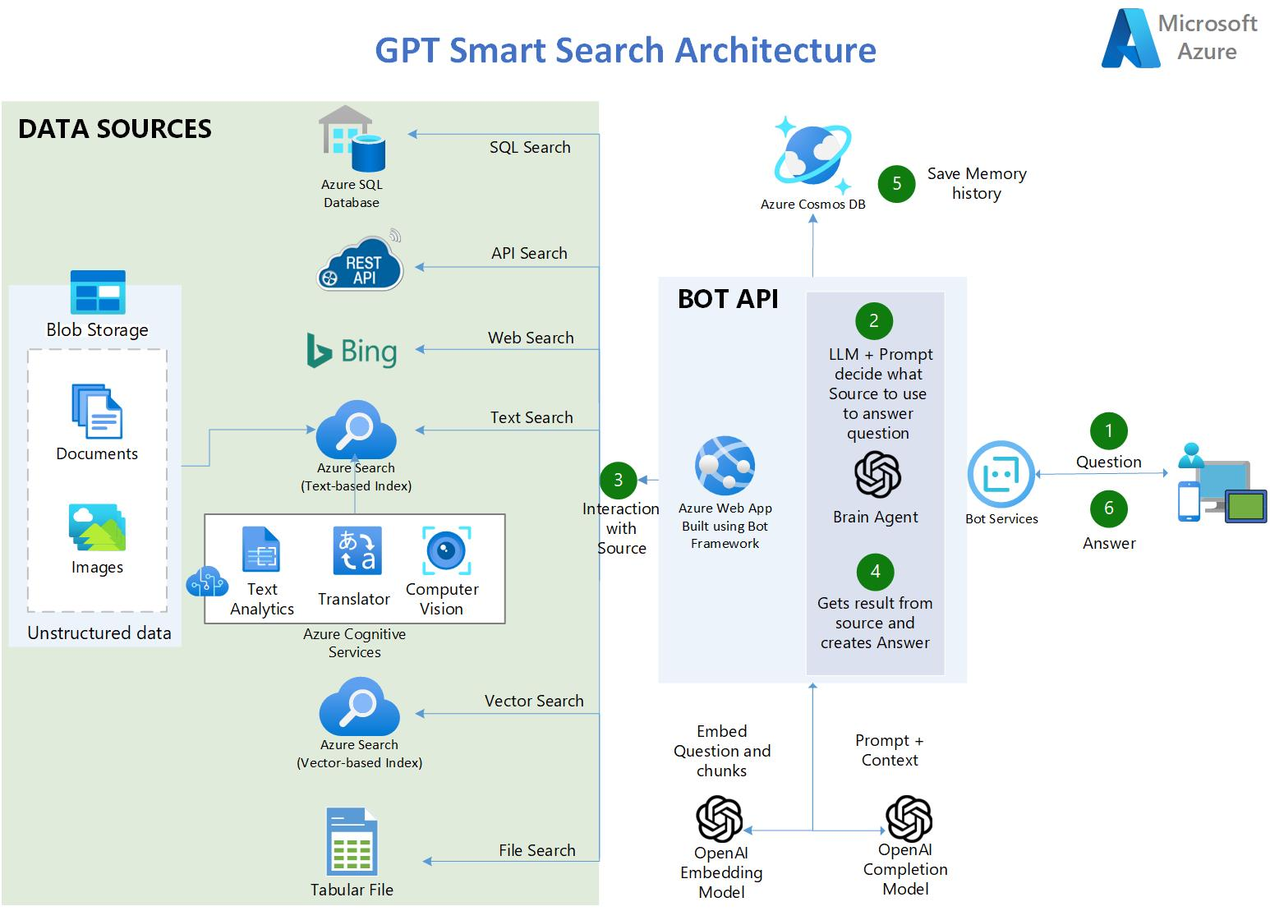

Slide 10
Next steps: How to engage?
Discovery Call
Proof of Value
Deployment
Call with the client to assess qualification to the program
Offering: 3-day CSU-led workshop with experts on Azure OpenAI
CSU team, during the workshop, helps the interested customer build a Proof of Concept (POC) using their own data and their own Azure subscription
Production Smart Search System building (code-with) and deployment with guidance and support from the technical specialists (CSA) and Partners
60 minutes
3-5 days
4-8 weeks
Notes:
Next Steps – Transition to Tech Pitch
The next step is to take a deeper dive into how it works and discuss proof of value.
[Field Note: At this point, we transition from the business value discussion to a more technical portion of the deck. You may continue to walk through it with a TDM at this point or at a later date, as needed. The slide that follow will provide a demo for configuring the Accelerator).

Slide 11
Thank you!

Slide 12
2 Day Workshop Agenda
Day 1: Overview & setup of AI/ML environment in customer Azure subscription
Day 2: Hands on - Customer use case model building and deployment
Time | Workshop Activity
9:00-11:30am (2.5 hours) | Quick Overview of Azure AI/ML Platforms & Services
 | Setup Unified Data Engineering, Analysis & AI Platform Environment (Storage & Azure Databricks)
 | Theory on Smart Search Engine Methods
11:30-12:30pm (1 hour) | Lunch
12:30-5:00pm (4.5 hours) | Provision & Configure Azure Machine Learning Services; Review Key Azure Machine Learning SDK for Python Concepts
 | Plan for Next Day – Deep dive to understand customer Smart Search Use Case
Time | Workshop Activity
9:00-11:30am (2.5 hours) | Deploy Azure resources, create your data source, Search Index, Skillsets, and Indexer within your Cognitive Search Service. Enrich Documents: We enrich your documents by creating specific skillsets that extract key information, apply OCR, generate translations, and more once your data source is created. Define Index: We define your index with your data schema and connect it to our search service apart from your primary data stores, allowing us to achieve millisecond response times in our application. Run through Indexer Pipeline: We use the data source, skillset, and index as inputs to run through our indexer pipeline. By creating the indexer on Azure Cognitive Search, it triggers the event to put the entire pipeline into motion.
11:30-12:30pm (1 hour) | Lunch
12:30-5:00pm (4.5 hours) | Practice querying across your data leveraging the power of Azure Open AI, finalize your solution by deploying a web application to easily share with other to also use. Set Azure Open AI Parameters: We deploy and set your Azure Open AI parameters, specifying how much data to pull in from cognitive search results for comparison with output vectors from search, semantic search, and Azure Open AI. Leverage Langchain Library: By leveraging the Langchain library, we can compare search results and accuracy of using Azure Cognitive Search versus Azure Cognitive Search + Azure Open AI, showcasing the power of Azure Open AI. Deploy Web Application: We deploy the web application by connecting it to our forked Github repository. This allows you to query data in a beautiful UI and receive top results powered by Azure Open AI.
Notes:
TALK TRACK:
Our solution streamlines the process of deploying Azure resources and creating a robust search engine. By creating a data source, Search Index, Skillsets, and Indexer within your Cognitive Search Service, we ensure that your data is easily accessible and searchable.
Our solution also enriches your documents by creating specific skillsets to extract key information, apply OCR, generate translations, and more. This enriches your data and ensures that your search results are accurate and relevant.
We define your index with your data schema and connect it to our search service. This allows us to have millisecond response times in our application, providing a fast and efficient search experience for your customers and employees.
Finally, we use the data source, skillset, and index as inputs to run through our indexer pipeline. By creating the indexer on Azure Cognitive Search, we trigger the event to put the entire pipeline into motion, ensuring that your search results are comprehensive and up-to-date. Our solution saves time and resources while providing a powerful search engine for your organization.
With our solution, you can practice querying across your data and leverage the power of Azure Open AI to enhance your search results. We'll help you finalize your solution by deploying a web application that's easy to share with others.
To get started, we'll set your Azure Open AI parameters, pulling in the right amount of data from your cognitive search results. We'll compare the output vectors from search, semantic search, and Azure Open AI to ensure that you're getting the best possible results.
By leveraging the Langchain library, we can compare search results and accuracy of using Azure Cognitive Search versus Azure Cognitive Search + Azure Open AI, showcasing the power of Azure Open AI.
Finally, we'll deploy the web application by connecting it to our forked Github repository. This allows you to query data in a beautiful UI and receive top results powered by Azure Open AI. With our solution, you'll have a powerful search engine that's easy to use and share with others.

Slide 13
The Benefits
Smart and Multilingual Search Engine: Provides links and answers to search queries, improving the search experience for customers and employees.
Simplifies AI Implementation: Solves 80% of use cases for companies, without requiring retraining or hosting models.
Python Code Deployment: All Azure services and configurations can be deployed via Python code, making it customizable and easy to maintain.
Enriched Search Results: Uses Azure Cognitive Services to improve the accuracy of search results, detecting languages, OCR images, and recognizing entities.
Streamlined Search Process: Uses LangChain as a wrapper for interacting with Azure OpenAI, vector stores, and constructing prompts.
User-Friendly Interface: Uses Streamlit to build the web application in Python, providing an intuitive interface for customers and employees.
Personalized Recommendations: Coming soon, the search engine will recommend new searches based on users' history, further improving the search experience.
Notes:
In comparison with this MSFT accelerator, our Retail Recommender Solution Offering is much simpler to setup. It doesn't require Synapse or Spark while at the same time can handle more than 95% of the retail cases
Uses not only the transaction log (Date, User_id, Item_id, Interaction), but can also use the Item master dataset and the user dataset in order to make quality predictions
Leverages side features for training and for prediction. Can take in consideration side features for transactions , users and items.
Can perform item similarity / basket analysis for upsell and cross sell
Produces as output an API on a docker image. That can be place in any cloud provider or on-premises
Contains deployment via Azure ML Services in: Azure Container Instance (Test), and Azure Kubernetes Service (Production)}
Also contains deployment for Azure Databricks MLFlow model serving
API Features: Top K recommendations, include or exclude set of items from the recommendation, uses side features at prediction time, specify specific features at inference time, allows querying similar items.

